Slide 1
SGU X ROCKET RIDE HACKATHON
ROUND 1 PRESENTATION
COLLEGE NAME : IMSEC / BBDIT
Team name : CODING DIVAS
Team leader : Aadya Dixit
Team Member: Khushbu
Problem Statement : Deepfake & Digital Media Authenticity Verification

Slide 2
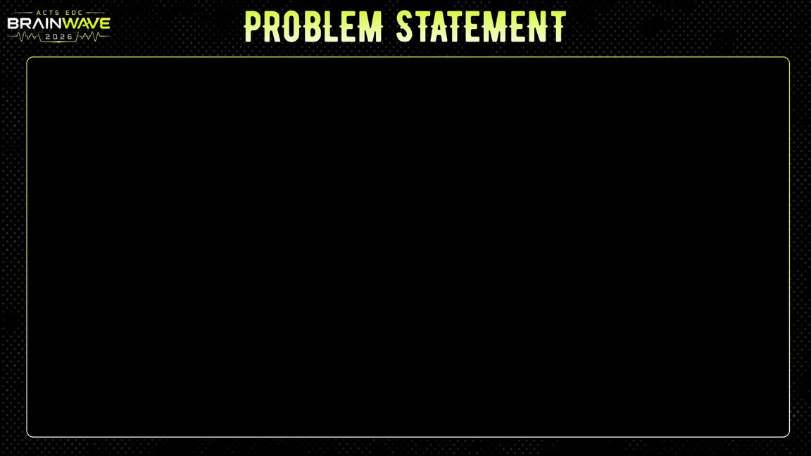
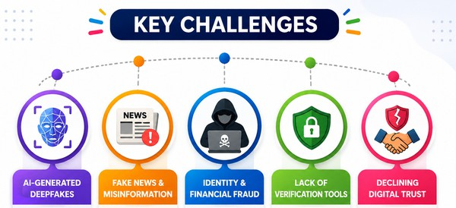
DeepFake & Digital Media Authenticity Verification Platform
Generative AI has made it difficult to distinguish real from AI-generated images, videos, and audio.
Deepfakes are increasingly used for misinformation, fraud, identity theft, and reputation damage.
Existing verification methods are slow, costly, and not easily accessible.
There is a need for an AI-powered, scalable, and automated platform to verify digital media authenticity with a confidence score before or after sharing.

Slide 3
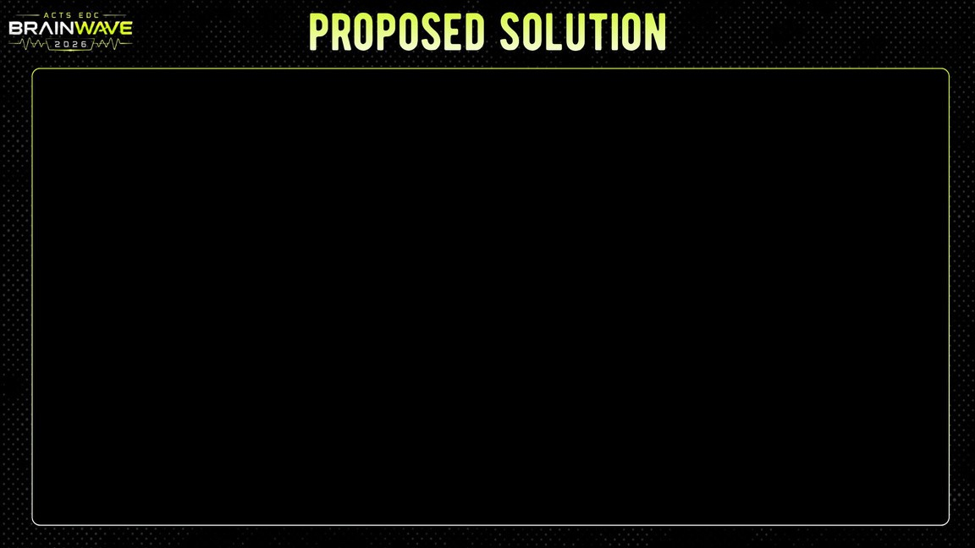
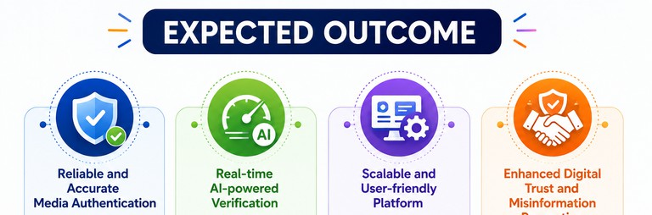
1. Our solution is AI-powered multimedia verification platform
Detects AI-generated images, videos, and audio
Performs metadata and digital forensic analysis
Identifies editing artifacts and visual inconsistencies
Generates an AI authenticity confidence score
Provides Explainable AI (XAI) verification reports
Supports pre-sharing and post-sharing content verification

Slide 4
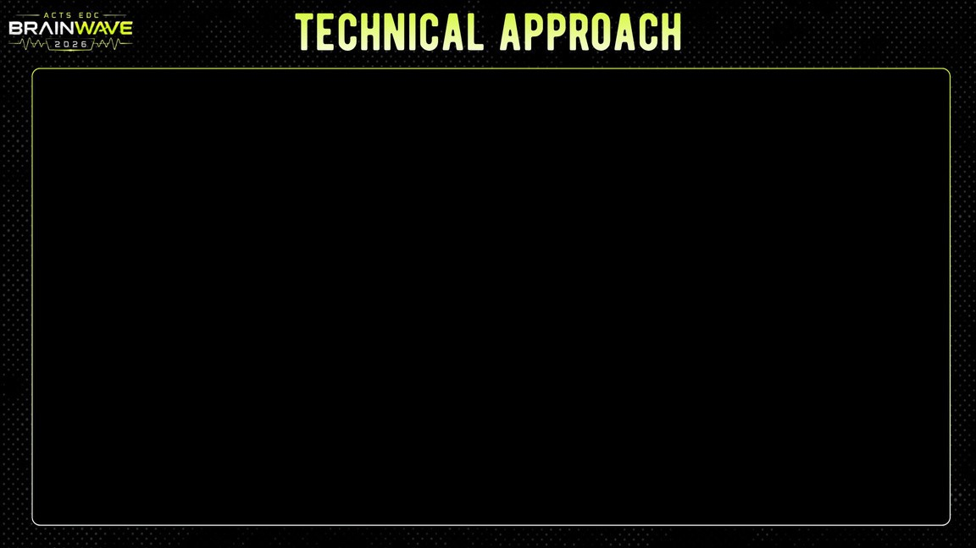
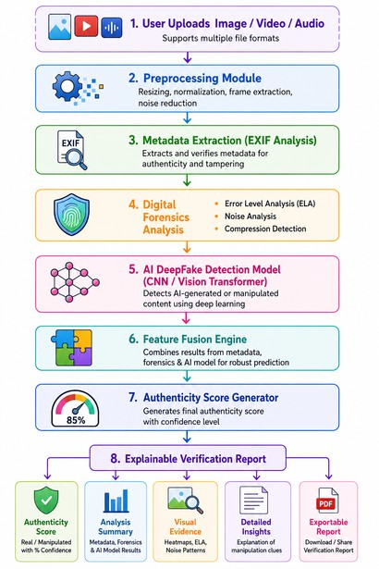
●
Process of implementation
Step 1
Collect authentic and manipulated datasets
↓ Step 2
Preprocess multimedia using OpenCV
↓ Step 3
Extract forensic and metadata features
↓ Step 4
Train Deep Learning models
↓ Step 5
Perform multimodal prediction
↓ Step 6
Generate confidence score
↓ Step 7
Display verification dashboard

Slide 5
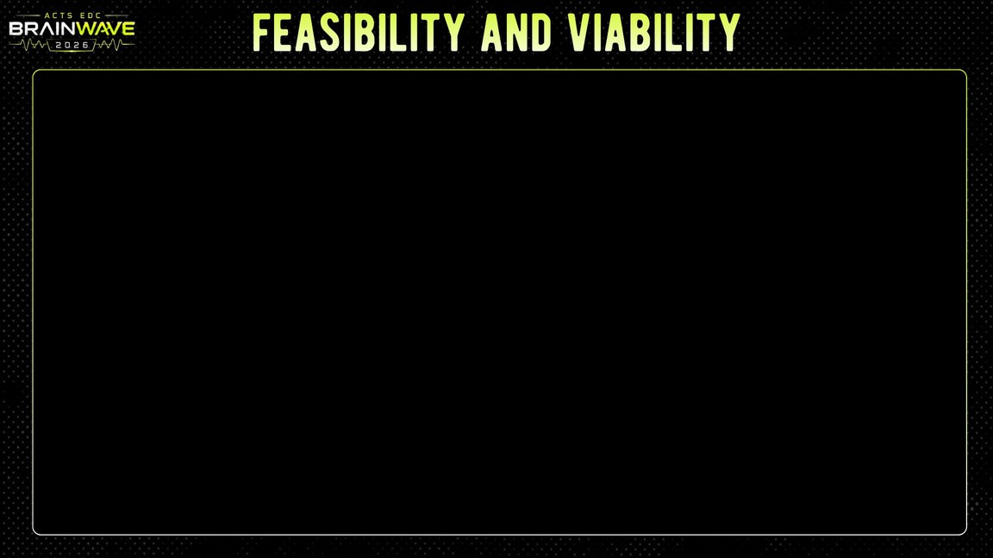
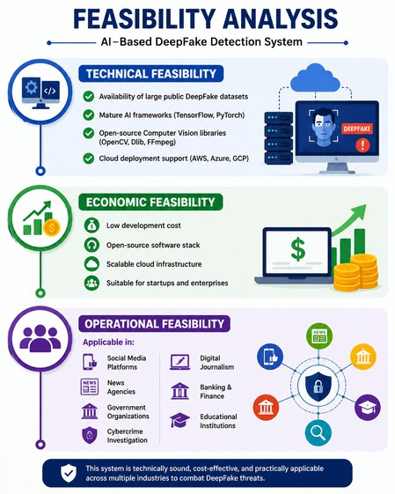
Viability
Addresses the growing need for digital media authentication and deepfake detection.
Helps prevent misinformation, fraud, and identity misuse.
Applicable in cybersecurity, journalism, law enforcement, and enterprises.
Provides a scalable solution for secure and trustworthy digital communication.
●

Slide 6
✔ AI-generated Image Detection
Methodology
●
✔ Confidence Score Generation
✔ Explainable AI Report
✔ User-friendly Dashboard
✔ Cloud-based REST API
✔ Secure File Upload
✔ Real-time Verification
✔ DeepFake Video Detection
✔ Synthetic Voice Detection
✔ Metadata Verification
✔ Error Level Analysis (ELA)
✔ Image Noise Analysis

Slide 7

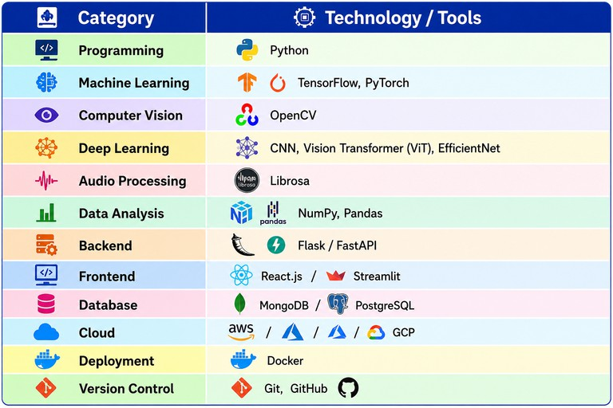
●

Slide 8
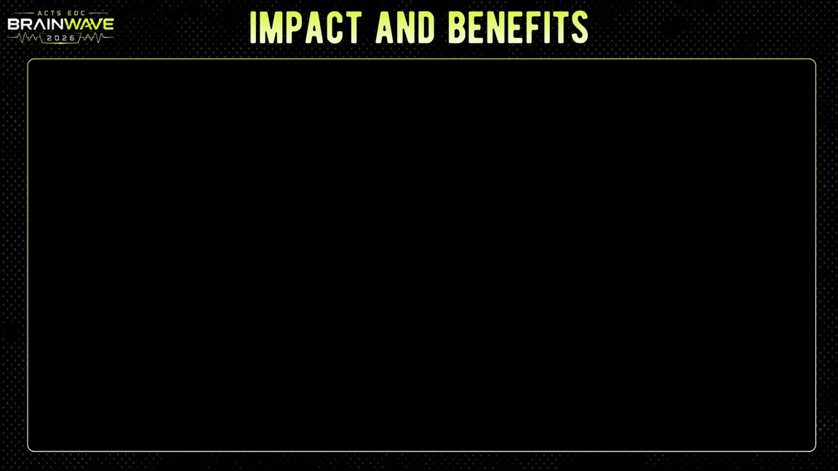
Reduce misinformation Increase digital trust Strengthen cybersecurity
Assist journalists and investigators Improve media authenticity verification
Impact
Support governments and organizations in combating AI-generated fraud
Benefits
Provides fast and accurate media authenticity verification. Protects users and organizations from identity misuse.
Enables reliable and secure digital communication.

Slide 9
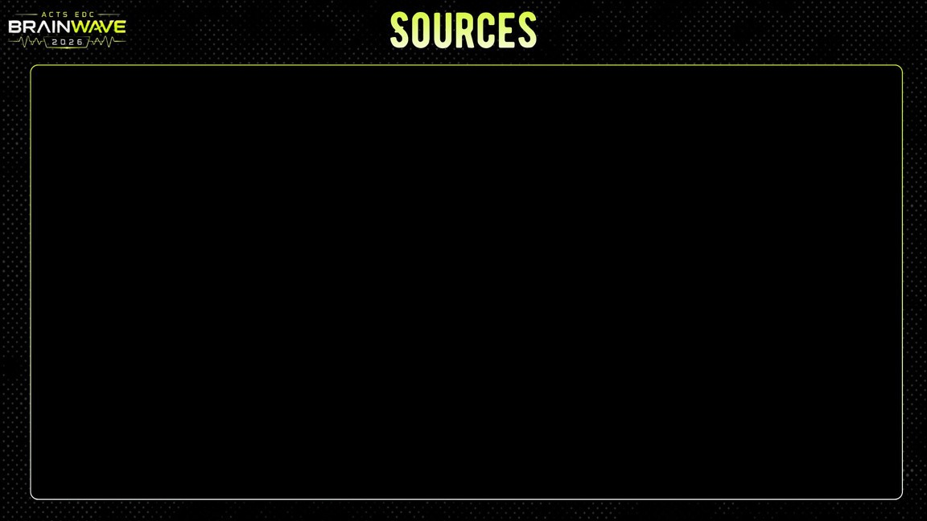
●
The idea is inspired by the growing misuse of Generative AI technologies and the increasing need for reliable
digital media verification
.
Research Sources
Google DeepMind research on AI-generated media OpenAI research on Generative AI
Meta AI DeepFake Detection Challenge FaceForensics++
DeepFake Detection Challenge (DFDC) Kaggle DeepFake datasets
IEEE Research Papers ACM Digital Library
CVPR & ICCV Computer Vision publications Cybersecurity reports from NIST and CISA

Slide 10
LINKS: 📄 Project Documentation Link: https://drive.google.com/file/d/1nSnvlPRMiSRlkxZHVSOFoifYg4Jv3yrp/view?usp=drivesdk 💻 GitHub Repository Link: https://github.com/aadyadixit17-code/DeepFake-Digital-Media-Authenticity-Verification 🌐 Working Demo Link: https://drive.google.com/file/d/1SnKgiu5cUtlZSPIOw0iM5paNZ7tB_5Pi/view?usp=drivesdk
TEAM MEMBERS DETAILS:- CODING DIVAS
Member AADYA DIXIT
IMS ENGINEERING COLLEGE
9315808067 aadyadixit17@gmail.com
Member 2: KHUSHBU
BABU BANARSI DAS INSTITUTE OF TECHNOLOGY
8368291701 sengarhemlata5@gmail.com

